Slide 1
Web scraping and analysis
Scraping data from Skytrax

Slide 2
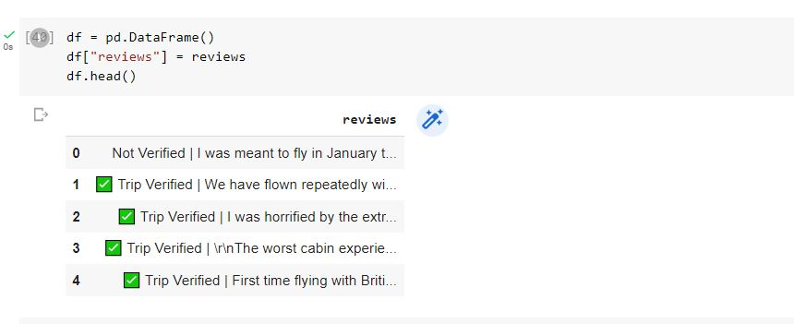
Collecting 1000 reviews

Slide 3
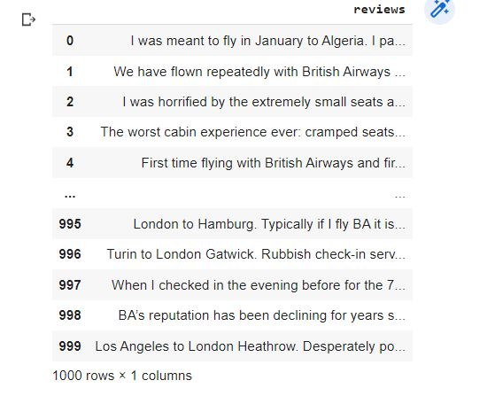
Data cleaning
clean this data to remove any unnecessary text from each of the rows

Slide 4
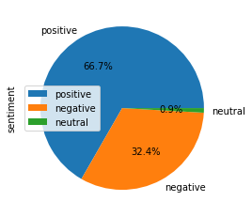
Sentiment
Out of 1000 reviews, 667 were positive, 324 were negative and 9 were neutral. This means the majority of reviews were polarised as either positive or negative.

Slide 5
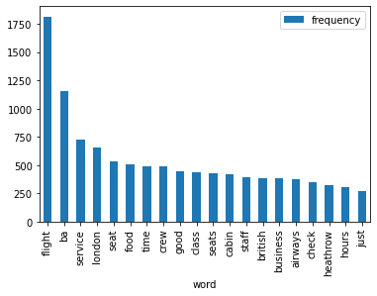
Key topics
The frequency chart below shows that the key topics within the reviews include “service”, “seat”, “crew” and “staff”, showing that people are actively talking about their experience and staff.

